Slide 1
Cloud Security Topic Guide
Editor: Andrew Martin
Author: Mark Buckwell
CyBOK Showcase / Edinburgh / 3rd November 2025

Slide 2
Content Types
Knowledge Area
Codify foundational and generally recognised knowledge in cyber security following broad community engagement nationally and internationally
Supported by processes for selection, review, change, and updating
Knowledge Guide
Review of relevant literature on a topic (typically on an emerging topic) that captures the current state of the field, key issues that learners should know about, emerging techniques to address those issues and open research problems.
Topic Guide
Draw together topics from across a number of KAs, to give a unified treatment to a collection of topics distributed across CyBOK.

Slide 3

Content Types
Knowledge Area
Codify foundational and generally recognised knowledge in cyber security following broad community engagement nationally and internationally
Supported by processes for selection, review, change, and updating
Knowledge Guide
Review of relevant literature on a topic (typically on an emerging topic) that captures the current state of the field, key issues that learners should know about, emerging techniques to address those issues and open research problems.
Topic Guide
Draw together topics from across a number of KAs, to give a unified treatment to a collection of topics distributed across CyBOK.
Supported by a similar (slightly lighter) process for review
– of ‘strawman’ outline and full draft.

Slide 4
CyBOK Topic Guides
“Topic Guides (TGs) draw together topics from across a number of KAs, to give a unified treatment to a collection of topics distributed across CyBOK. In general, these will be crosscutting themes where practitioner knowledge is more prominent than academic thinking. The great majority of a TG's content should be a synthesis of concepts from existing KA topics, but a small amount of additional material (with suitable references) should be included as needed to provide a comprehensive treatment of the topic. The size of a TG is typically 5-10 pages (excluding references).

Slide 5
NIST SP 800-145:
The NIST Definition of Cloud Computing
“Cloud computing is a model for enabling ubiquitous, convenient, on-demand network access to a shared pool of configurable computing resources (e.g., networks, servers, storage, applications, and services) that can be rapidly provisioned and released with minimal management effort or service provider interaction.”
NIST Essential Characteristics:
On-demand self-service
Broad network access
Resource pooling
Rapid elasticity
Measured service
Additional cybersecurity beneﬁts:
Strengthened security controls
Improved compliance transparency
Improved resiliency of services

Slide 6




Topic guide development approach focuses on making it useful to a wide audience
Focus on
Additional capabilities, issues and benefits that cloud computing brings
Available, emerging and near future capabilities
Adding value over existing available publications
Assisting students, practitioners and academics
Structure
Assume cloud computing fundamentals are understood
Structure is broadly aligned with cloud approach to security domains
Use of a diagram and document structure to locate information easily
Mapping to CyBOK and Cloud Security Alliance Security Guidance*
Content
Assume understanding of cloud principles and reference NIST for more detail
Brief description sufficient to identify relevant security principles/ capabilities but need further detail to understand
Embedded references in text for further detailed reading
Written independent of cloud providers and proprietary details
Reading sources
Priority given to open/free information sources
Used cloud provider sources if a better description
Used blogs sparingly as source could be removed
Add paid/restricted sources for added value
*Security guidance for critical areas of focus in cloud computing v5, cloud security alliance

Slide 7
Topic Guide Contents
Cloud Security Characteristics
Security Domains
Cloud Security Best Practices
Secure Design and Implementation Risks
CyBoK Knowledge Area Cross Reference
Cloud Security Alliance Cross Reference
References
Acronyms
Glossary

Slide 8
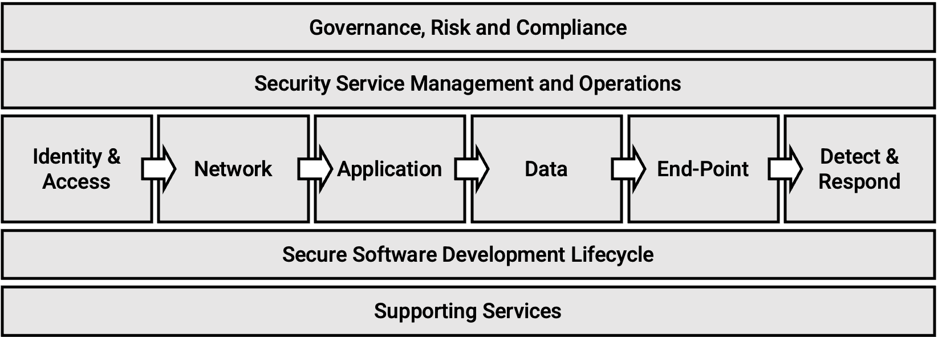
Security domain discussion aligned to cloud technical domains
Diagram for quick reference

Slide 9
What’s Next
Consensus scoping process
Strawman Draft
  with review feedback
Full draft
  expert review
Integrate feedback
  produce final draft
Copy editing and publication

