Slide 1
Security Informed Safety
Victor Lough

Slide 2
Overview of Content
Introduction
First Focus
Covering the groundwork of security Informed Safety
Understanding the Visible and Invisible Threats
Follow on Topics
Language, Likelihood, ALARP, HAZOP & LOPA, Governance, Safety and Security Design, Incident Response and Resilience, Requirements for Reconciliation
After Market Security Informed Safety
Skills Knowledge and Competency, Topics & Standards, Patching os systems with safety cases, Architecture.
Specialist Areas Mapping to Differing Regulatory Authorities
Authorities, Supply Chain, Novel Technologies, Quantitative Assessments, Organisational Culture.
References & CyBOK Cross References

Slide 3
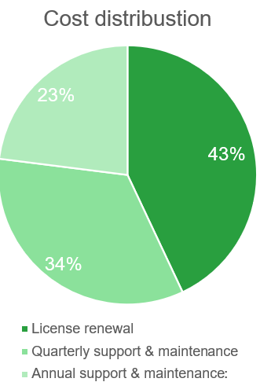
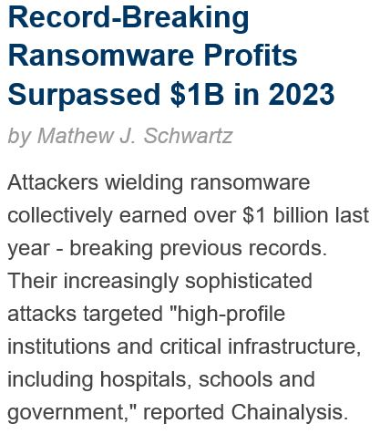
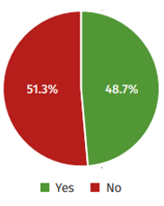
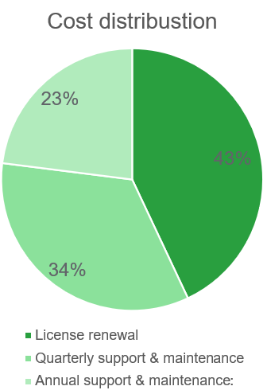
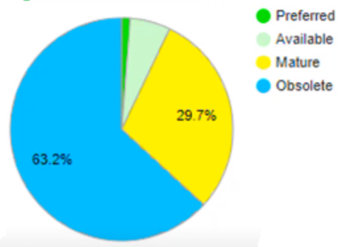
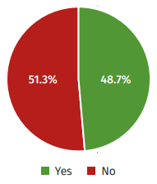
Introduction: The Hybrid War against Underinvested CNI Systemsc
Truth Descending on the Arts and Science :- Inspired by Sheldonian Theatre Painted Ceiling, Oxford University commissioned Streater’s personification of Truth triumphing over Envy, Rapine, and Ignorance. Following Civil War and Interregnum*, 1669.*period of absence of control which has parallels with current Hybrid War Environment.
X 2 Sites
% Certified ICS Security Professionals
ENVY
“The admiring discontent aroused by the achievements of others””
IGNORANCE
“Lacking knowledge, information or education”
RAPINE
“The plundering of property”

Slide 4
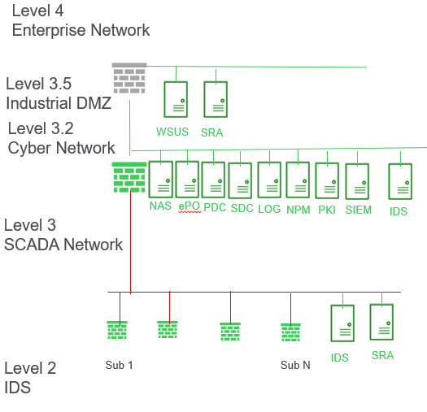
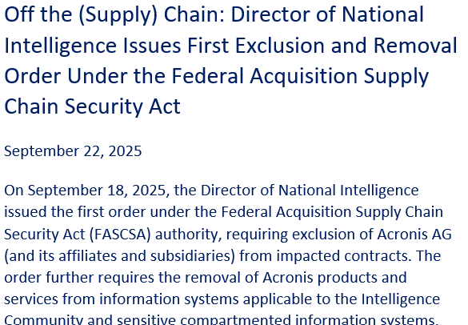

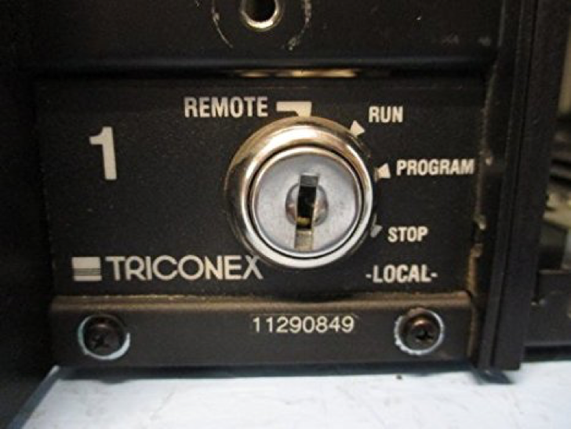
The Challenge.
ofgem have mandated Enhanced Profile (EP) compliance by Dec 2027 (~ SL 2.5).
From a Safety standards perspective , Srcurity must be considered as part of the safety case.
“ The bottom line is this: We do over 600 red teams a year. Firewalls never stopped one of them”
CVE CRITICAL
CVE CRITICAL
Not Deployable
CVE CRITICAL
FireEye CEO Kevin Mandia response to Senate Intelligence Committee questioning, following the Solar Winds Hack – NSA Urges Defense Sector to Adopt Zero-Trust.
Level 3
SIS
A nominal response to achieve IEC-62443 requirements for Enhanced Profile (SL 2.5)

Slide 5
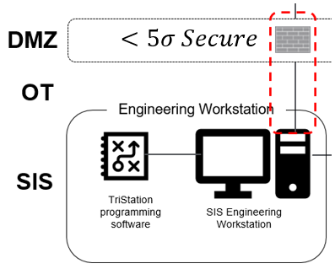
Security Informed Safety – A Multi – Causality Model
Feedback Loops from Defence in Depth
PRODUCTION
Decision Makers
Corporate Management
Line Management
Operations, Maintenance, etc
Preconditions
Defence in Depth
Reliable Equipment, skilled workforce, etc
Defences
Strategies to prevent corporate CHAOS
Productive activities
Integration of human and machines
Success
Failure
Fallible Decisions
Line Management deficiencies
Accident precursors
Latent Errors
Unsafe acts and conditions
Enabling Conditions
Incident Crisis CHAOS
Governance
Violations
Inadequate defences
Multi-Causality Model (based on Reason -1997)

Slide 6
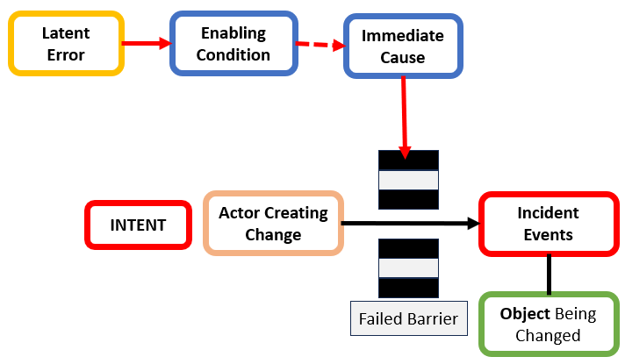
The Outcome
Cyber security must consider physical safety
Physical safety must consider cyber security
Normalcy Bias: Operators, engineers, and vendors focus on failures they understand and expect
Under-Investment of Legacy Equipment: Business needs to fully understand the Consequence Risk
Under-scoping an investigation:
Can lead to missed opportunities to learn from the incident and disrupt future attacker activity
Better Intelligence sharing for earlier detection
Direct first, supply chain second
A Focus shift from Security to Resilience
The Cyber Breach Causation Path
Notes:
Mandiant’s role:
- Safety
- Remediation (OT)
- Remediation (IT)
SE’s role:

